Slide 1
Working with Rasters
Gregory Brunner

Slide 2
Things we can do with raster data
Display
List and Describe
Analysis – Spatial Analysis and Map Algebra
Raster Objects
Numpy arrays
Mosaic (we’ll cover this next week)

Slide 3
Listing Rasters

Slide 4
Describing Rasters

Slide 5
Analysis – Map Algebra
We can treat rasters as objects in Python
Simple and powerful algebraic expression through Spatial Analysis Tools
Available through Spatial Analysis module
Integrated into Python

Slide 6
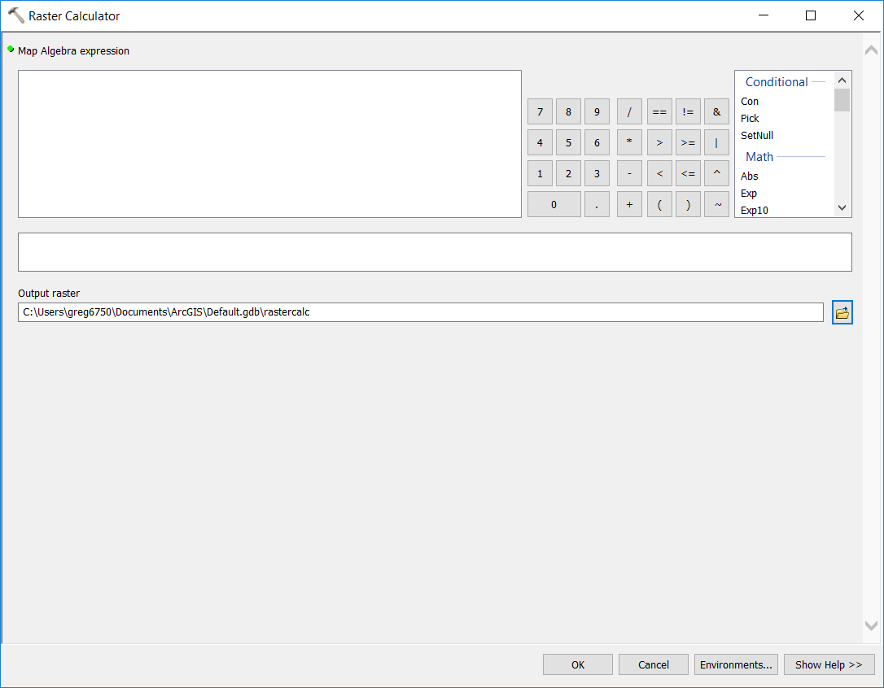
Ways to Access Map Algebra
Raster Calculator tool in ArcMap
Python Window
Python scripting

Slide 7
Importing Spatial Analyst Module

Slide 8
Syntax

Slide 9
Demo: List and Process Rasters

Slide 10
Demo: Raster Processing with Numpy

